Slide 1

Customer Shopping Behavior Analysis
Uncovering insights from transactional data to guide strategic business decisions.

Slide 2
Project Overview
Analyze 3,900 Purchases
Uncover Key Insights
Guide Strategy
Transactional data across various product categories.
Spending patterns, customer segments, product preferences, subscription behavior.
Inform business decisions for growth and optimization.

Slide 3

Dataset Summary
Data Dimensions
Rows: 3,900
Columns: 18
Key Features
Customer demographics
Purchase details
Shopping behavior

Slide 4
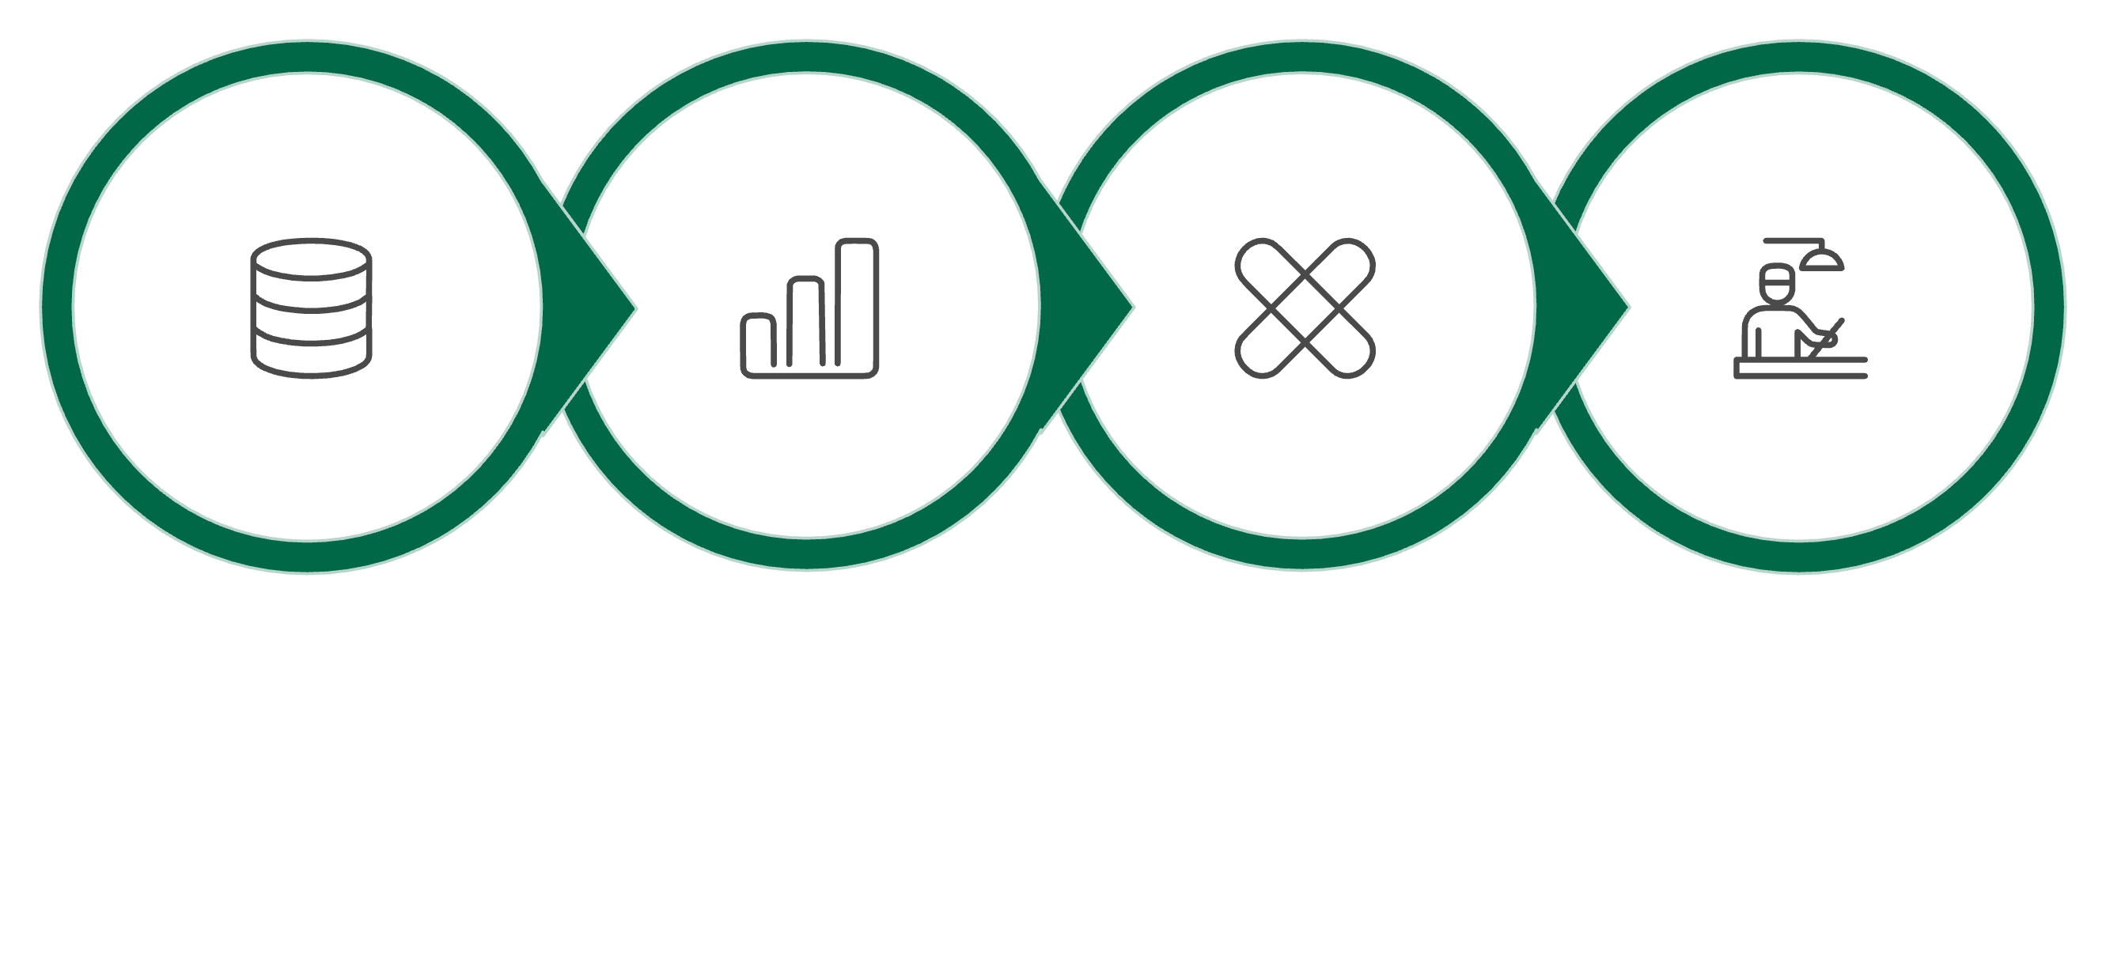
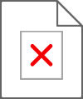
Exploratory Data Analysis (Python)
Missing Data Handling
Data Loading
Initial Exploration
Feature Engineering
We prepared and cleaned the data using Python for robust analysis.

Slide 5
Data Analysis (SQL)
Revenue by Gender
High-Spending Discount Users
Female: $75,191, Male: $157,890
839 high-spending customers used discounts.
Top 5 Products by Rating
Shipping Type
Gloves, Sandals, Boots, Hat, Skirt
Express shipping has higher average purchase.

Slide 6
SQL Insights: Subscriptions & Discounts
Subscribers vs. Non-Subscribers
Discount-Dependent Products
Subscribers: 1053, Avg Spend: $59.49, Revenue: $62,645
Hat: 50% discounted purchases
Sneakers: 49.66% discounted purchases
Coat: 49.07% discounted purchases
Non-Subscribers: 2847, Avg Spend: $59.87, Revenue: $170,436

Slide 7
SQL Insights: Customer Segmentation
New Customers
Returning Customers
Loyal Customers
83 customers
701 customers
3116 customers
Segmentation based on purchase history for targeted engagement.

Slide 8
Top Products per Category
1
Accessories
Jewelry
171
1
Clothing
Blouse
171
1
Footwear
Sandals
160
1
Outerwear
Jacket
163

Slide 9
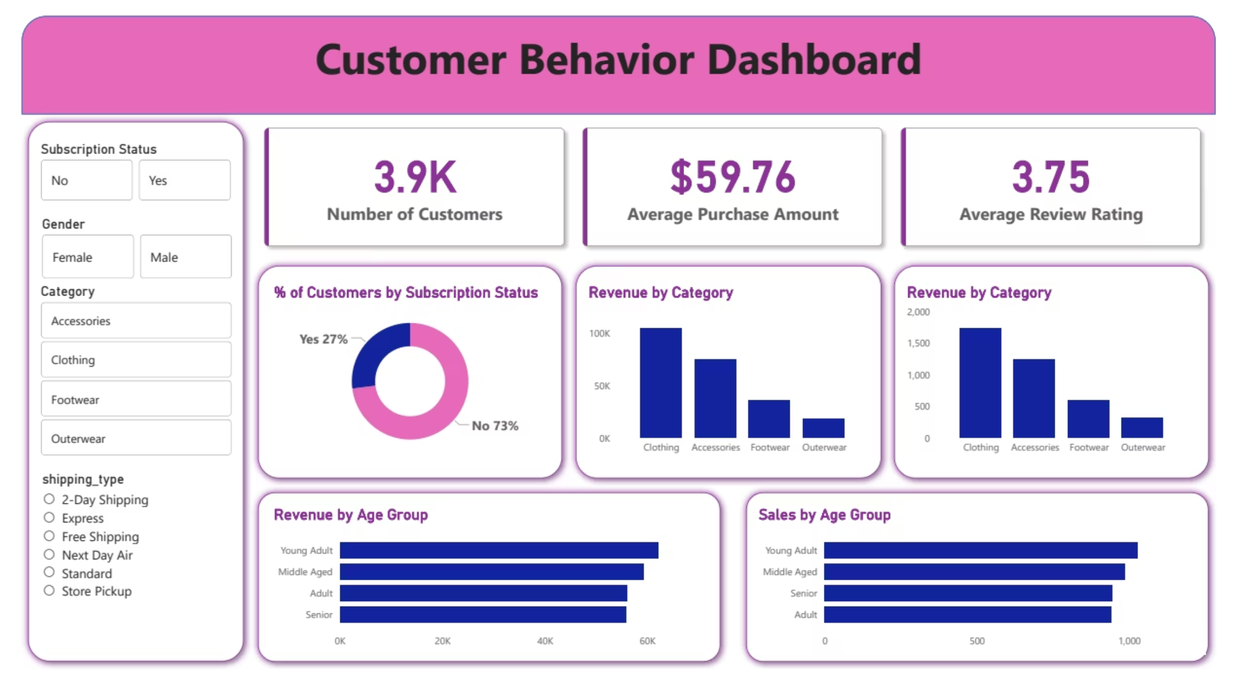
Dashboard in Power BI
Interactive visualizations for key customer behavior metrics.

Slide 10
Business Recommendations
Boost Subscriptions
Promote exclusive benefits for subscribers.
Customer Loyalty
Reward repeat buyers to foster loyalty.
Review Discount Policy
Balance sales with margin control.
Targeted Marketing
Focus on high-revenue age groups and express-shipping users.
Product Positioning
Highlight top-rated and best-selling products in campaigns.

